Slide 1
Chapter 10 – Strings
Reading Assignment: Chapter 10, Sections 1 - 2 in Introduction to Programming with C++, 3rd Edition, by Liang.
Strings can be handled in a couple of ways:
1) Using character arrays or C style strings, or C-strings. This is a good way to handle strings of characters and is still used, especially in existing software. C-strings are covered in section 7.11 of the textbook. We will not use C-strings in this course.
2) Using the C++ string class. There are advantages to using C++ strings over character arrays and this is probably the better choice for new software. C++ strings were introduced in section 4.8, but are covered more extensively in sections 1-2 of Chapter 10.
We will briefly introduce character arrays and then cover using the C++ string class more thoroughly.
Notes:
1

Slide 2
Character Arrays (C-strings)
Character variables
Recall that character variables are used to store single characters, where the value of the character is in single quotes. Also recall that escape sequences such as \n, \t, \v, \0, etc., are treated as single characters
Example: char Grade = ‘A’, Tab = ‘\t’;
Character arrays can store one character per array element, but need to leave at least one empty space at the end for the null character (\0).
Example: char Name[5];
Name[0] = ‘J’;
Name[1] = ‘o’;
Name[2] = ‘h’;
Name[3] = ‘n’;
Name[4] = ‘\0’;
Grade
A
Tab
\t
Name
J | o | h | n | \0
Notes:
2

Slide 3
Declaring character arrays
Character arrays are used to store strings of characters.
Space must be left for the null character (\0) at the end of the array, so the array size should be one larger than the maximum string length.
C++ does not check for array boundaries, so exceeding the length of a character array (or any array) will overwrite other items in memory and might crash the computer.
Examples: char A; // single character
char B[2]; // 1 character + null character
char C[3]; // 2 characters + null character
char D[100]; // 99 characters + null character
Notes:
3

Slide 4
Initializing character arrays
Character arrays can be initialized one character at a time. Be sure to terminate the array with the null character
Strings are loaded into character arrays using the strcpy function.
Form: strcpy(CharacterArrayName, “string”)
strcpy automatically adds the null character at the end of the string
Include the cstring library which contains strcpy
Example: #include <cstring> // library with strcpy
char X[4], Y[4]; // declare char arrays
X[0] = ‘A’; // load one char at a time
X[1] = ‘B’;
X[2] = ‘C’;
X[3] = ‘\0’;
strcpy(Y, “DEF”); // load an entire string
X
A | B | C | \0
Y
D | E | F | \0
Notes:
4

Slide 5
Exceeding character array bounds
As mentioned earlier, C++ does not check for array boundaries, so exceeding the length of a character array (or any array) will overwrite other items in memory and might crash the computer.
Example: #include <cstring>
char City[10], State[3],Zip[10];
strcpy(Zip, “23453”);
strcpy(State, “VA”);
strcpy(City, “Virginia Beach”);
Zip
2 | 3 | 4 | 5 | 3 |  |  |  |  | \0
State
V | A | \0
City
V | i | r | g | i | n | i | a |  | B | e | a | c | h
Error! Overwriting other items in memory!
Notes:
5

Slide 6
Functions for C Style Strings (character arrays)
There are a number of functions available for working with character arrays. Since we will focus on the C++ strings class instead (which uses different functions), the C-style functions are only listed below. If you work across an existing program that uses C-style strings, you may see many of these functions used. A table in the text gives details for each function.
isalnum | toupper | strchr
isalpha | atoi | strcspn
iscntrl | atof | strpbrk
isdigit | atol | strrchr
isgraph | strtod | strspn
islower | strtol | strstr
isprint | strtoul | strcmp
ispunct | strcat | strncmp
isspace | strcpy | strlen
isxdigit | strncpy | strerror
tolower | strtok
Notes:
6

Slide 7
C++ String Class
Recall that we are opting to spend most of our time using the C++ string class rather than C-style strings (character arrays). Why?
Advantages of C++ Strings:
C++ strings do not need brackets for single strings
The size of C++ strings does not need to be specified, so we do not need to worry about exceeding the string size. C++ determines the string size and expands memory to accommodate the strings.
C++ strings allow the use of operators to perform string operations (such as + to join two strings together)
C++ strings do not require the null character (\0) at the end of a string.
It is safer to use C++ strings (no worry of crashing computer if a string is too long).
Notes:
7

Slide 8
Advantages of C-style strings (character arrays):
Programs using C-style strings are probably faster.
Some functions may require C-style strings so if we are using C++ strings, we may have to convert them to C-style strings. Recall that some compilers require this when using variable names for data files.
#include <iostream>
#include <fstream> // uses of C-strings for filenames
#include <string>
using namespace std;
int main()
{ string File1; //C++ string
cout << "Please enter name of file: " ;
cin >> File1;
double number;
ifstream Infile(File1.c_str()); // convert to C-string
…
Notes:
8

Slide 9
Classes
We will cover classes in more detail soon, but we can use a class without being too concerned about the details of how it is written. However, let’s review some simple class terminology introduced earlier where we used the fstream class when working with files.
Items declared in classes are referred to as objects.
Many class functions (called member functions) required the use of dot notation.
Classes may define their own operators or redefine (overload) common operators.
Notes:
9

Slide 10
Example: Using class ifstream
# include <fstream> // use with classes fstream, ifstream, ofstream
…
ifstream InData; // InData is declared as an object in class fstream
InData.open(“My.dat”); //dot notation & the member function open used
InData.close(); //dot notation & the member function close used
Example: Using class string
# include <string> // use with class string
…
string S1, S2, S3; // S1, S2, S3 are declared as objects in class string
S1 = “John“; // S1 initialized
S2 = “Doe”;
S3 = S1 + S2; // The + operator has been redefined in class
// string to join to strings together (concatenation)
S3.insert (4, “ Q. “); // dot notation and member function insert
// used to insert a string after the 4th position in string S3.
cout << S3 << endl; // John Q. Doe will be displayed
Notes:
10

Slide 11
Declaring strings
Similar to declaring variables for types (such as double X;)
Same rules for identifier names as with other variables
Form: string StringName;
Example:
string College, Semester, Course, Last_Name;
string x,y,z;
Initializing strings
Can be initialized in two ways:
Using the = operator (when the string is declared or later)
Putting the string value in parentheses when the string is declared.
In either case, the string value is place in double quotes.
Example:
string College = “TCC”; // declare and initialize
string Last_Name (“Doe”); // declare and initialize
string Course; // declare
Course = “EGR 125”; // initialize
Notes:
11

Slide 12
Operators
C++ has overloaded some of the arithmetic and relational operators to work with string objects.
Concatenation (+, +=)
The + operator is used for concatenation, or to join two strings.
Similarly, += can be used to add a string on to the end of another string.
Example:
string Prefix = “EGR”, Number = “125”;
string Course, Suffix = “-N02B”;
Course = Prefix + Number; // concatenation
cout << Course << endl; // Output: EGR125
Course += Suffix; // concatenation
cout << Course << endl; // Output: EGR125-N02B
Notes:
12

Slide 13
Relational operators
Relational operators are used to compare two strings
Strings are compared based on:
ASCII value – refer to the table of ASCII Codes on the next slide
Lexicographically – basically refers to the ordering that might be used in a dictionary. A word that would occur earlier in the dictionary is less than a word that occurs later in the dictionary. Example: “Williams” < “Williamson”
Examples:
Circle True or False for each relational expression below:
“A” < “B” True False
“A” < “a” True False
“A” < “AA” True False
“John” < “John Doe” True False
“1” < “2” True False
“123” < “1111” True False
“A” < “1” True False
“Z” == 90 True False
Notes:
13

Slide 14
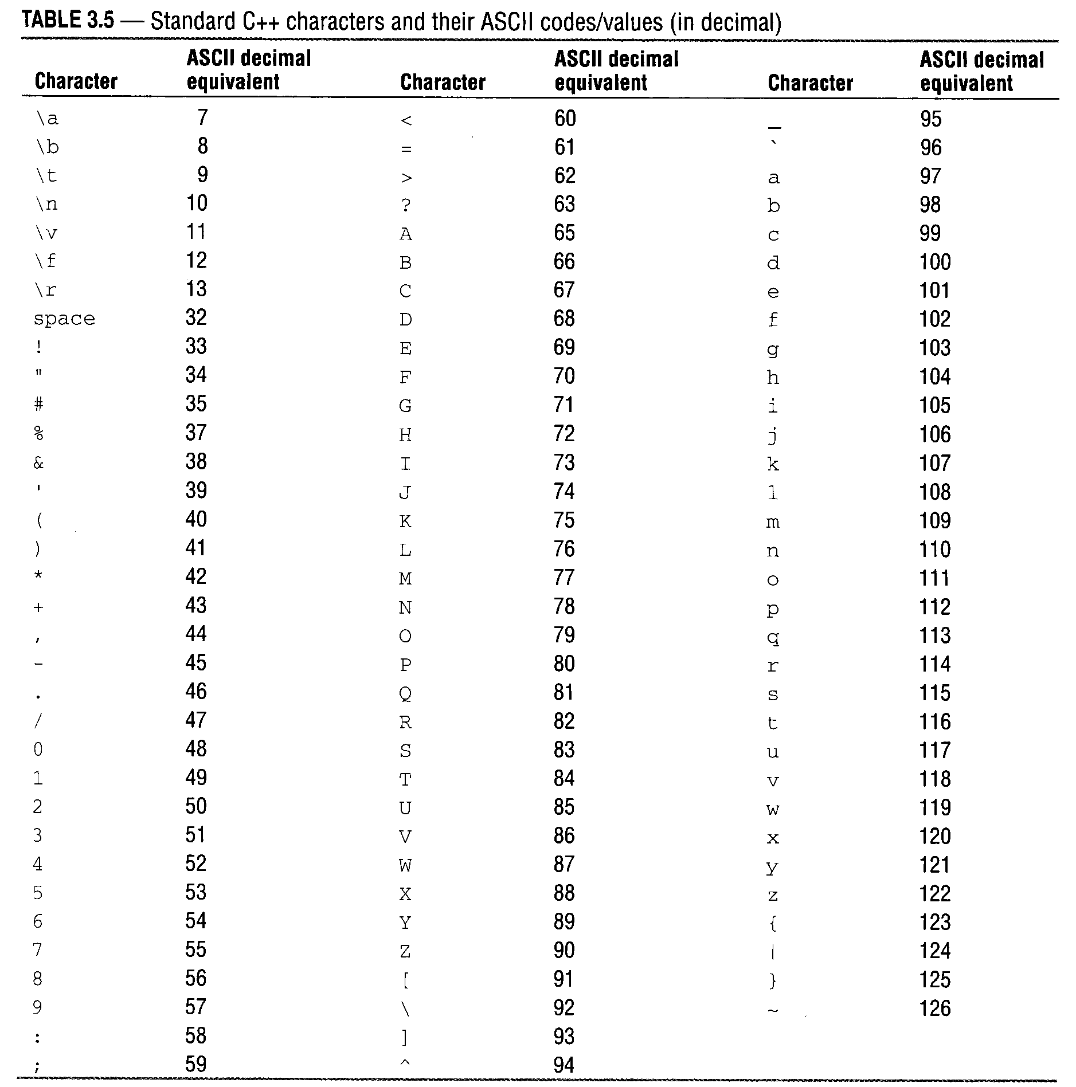
ASCII Codes
Notes:
14

Slide 15
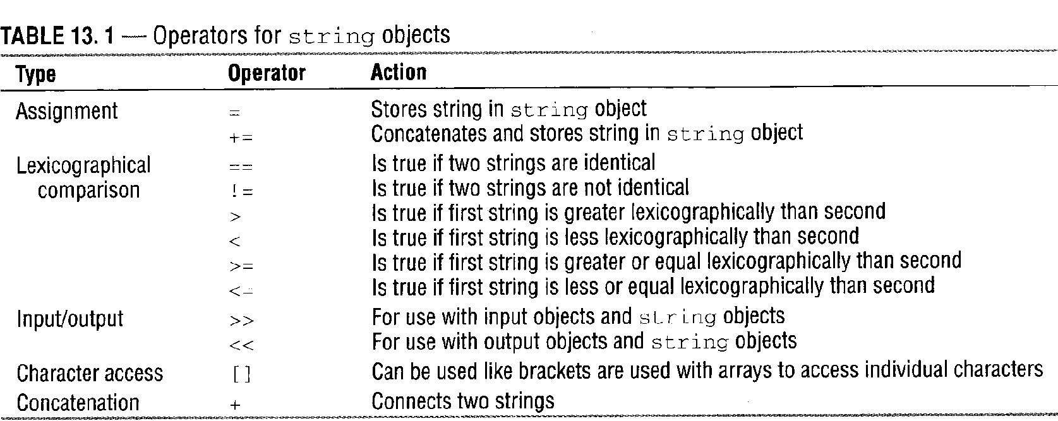
Character access using [ ]
Individual characters can be accessed using brackets, similar to the way elements in an array are accessed.
The first element in string S1 is S1[0].
Example:
string S1 = “Programming”;
cout << S1[0] << endl; // What is the output? _____
cout << S1[3] << endl; // What is the output? _____
15
Notes:
15
15

Slide 16
String Class Member Functions
There are many useful string operations that cannot be accomplished using operators so member functions defined in the string class are used. Let’s try one of the functions in detail: find
Recall that member functions are called using the object name with dot operator and the function name.
The find Function
Searches for a string within a string and returns the position of the first occurrence of String2 within String1 (returns -1 if not found).
Form: String1.find(String2)
Typical usage: int Position = String1.find(String2)
The find function is overloaded so that it may also be used with two arguments.
Alternate form: String1.find(String2, index)
In this case the function searches for the first occurrence of Sting2 beginning in position Index in String1
Example: (see next slide)
16
Notes:
16
16

Slide 17
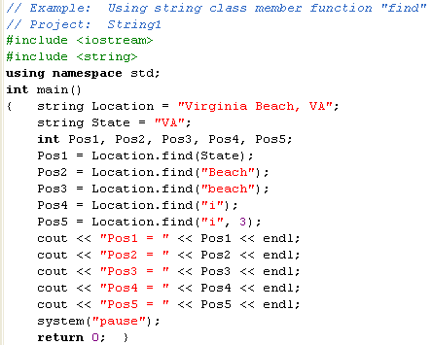
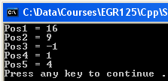
Example:
Discuss the results shown below.
V | i | r | g | i | n | i | a |  | B | e | a | c | h | , |  | V | A
Pos:
0 | 1 | 2 | 3 | 4 | 5 | 6 | 7 | 8 | 9 | 10 | 11 | 12 | 13 | 14 | 15 | 16 | 17
17
Notes:
17
17

Slide 18
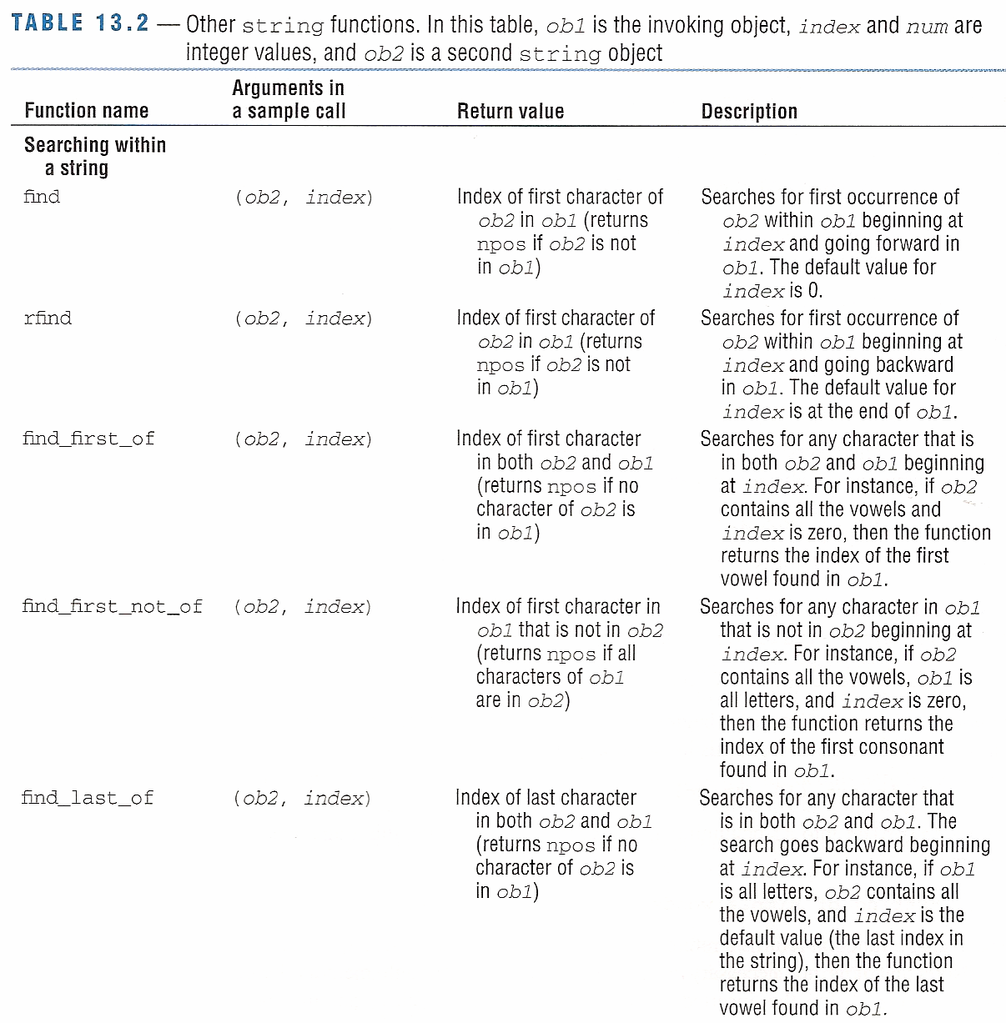
String
Functions
find
rfind
find_first_of
find_first_not_of
find_last_of
18
Notes:
18
18

Slide 19
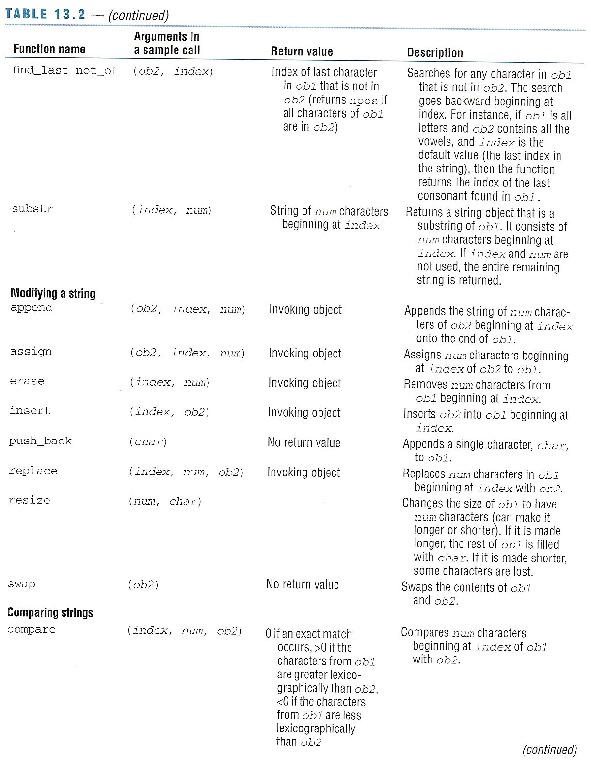
String
Functions
find_last_not_of
substr
append
assign
erase
insert
push_back
replace
resize
swap
compare
19
Notes:
19
19

Slide 20
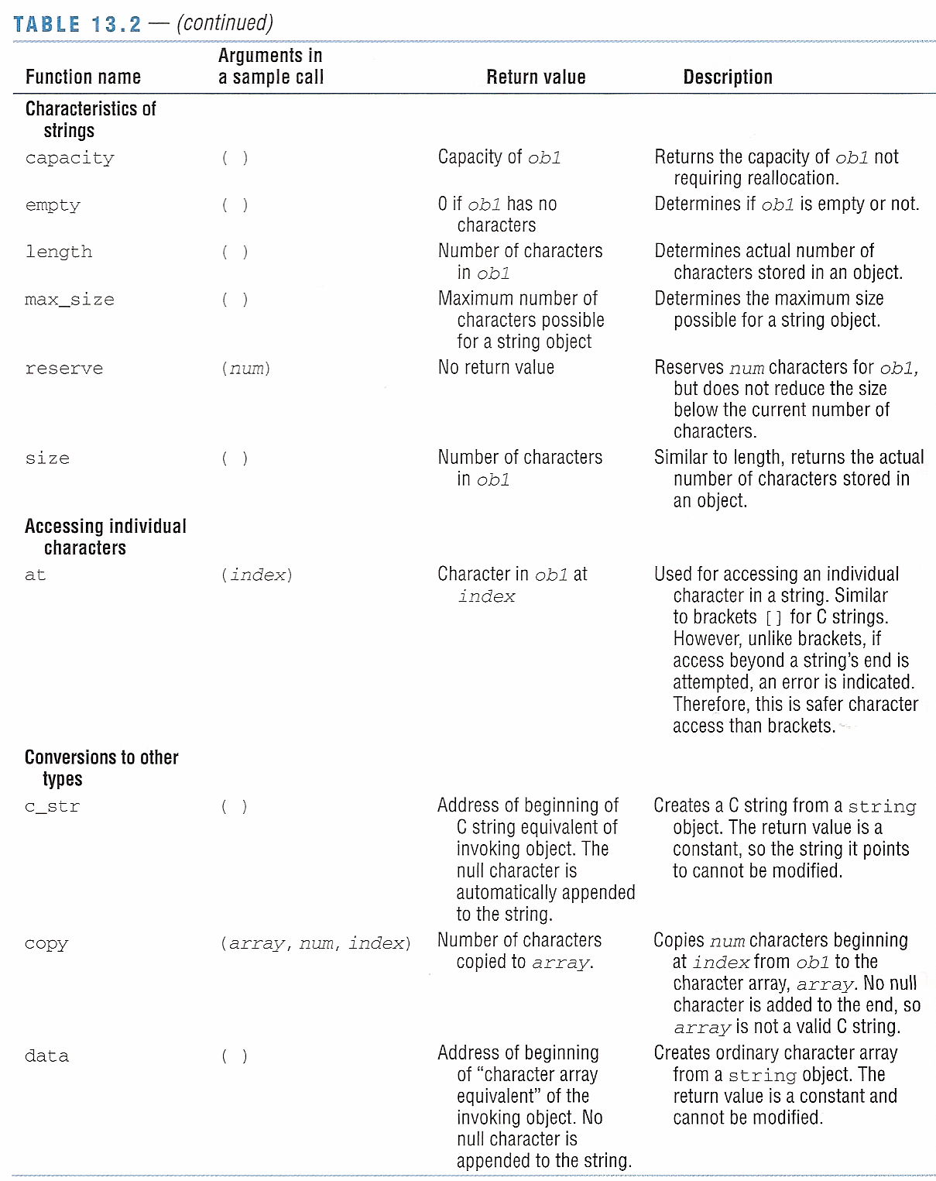
String
Functions
capacity
empty
length
max_size
reserve
size
at
c_str
copy
data
20
Notes:
20
20

Slide 21
Keyboard and file input
Strings can be read from files using cin, getline, and ignore.
Using cin to read string inputs
cin reads the input until the first white space is encountered.
cin in works well for reading one word at a time.
cin does not work for reading entire sentences (or lines in a file).
If a keyboard input has spaces, only the portion up to the first white space is read and the remainder of the input is left in the input buffer, where it may be used by the next input.
Example:
string Course;
cout << “Enter course: ”;
cin >> Course; //If the user enters Intro to Engineering
// then Course = “Intro” and the remaining
// characters are still in the buffer.
Example: See next slide
21
Notes:
21
21

Slide 22
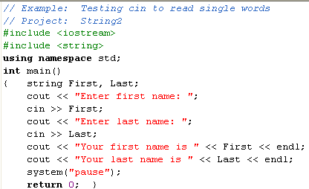
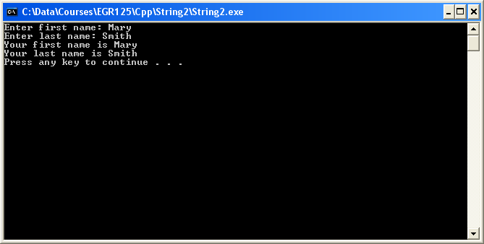
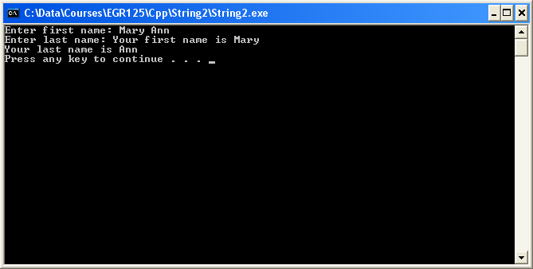
Case 1: Mary Smith enters her name (works correctly)
Error. Mary read as first name and Ann is left in the buffer. Ann is then automatically used for the last name.
Case 2: Mary Ann Smith enters her name
22
Notes:
22
22

Slide 23
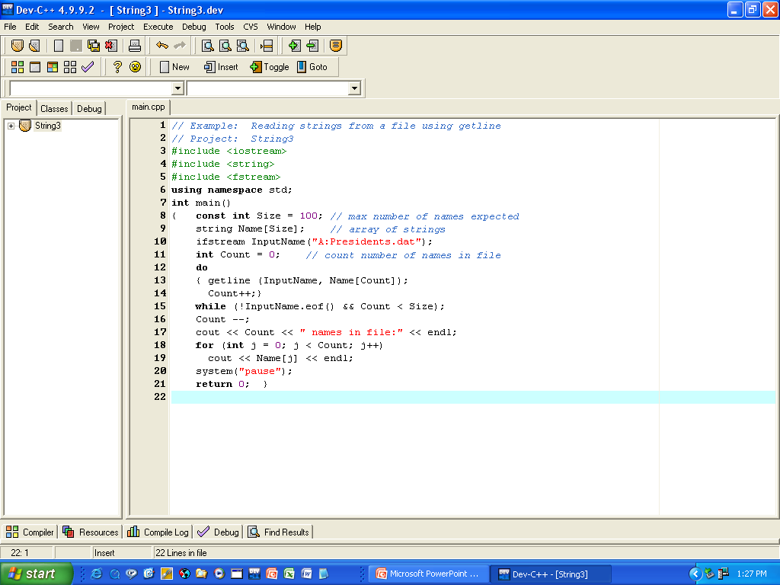
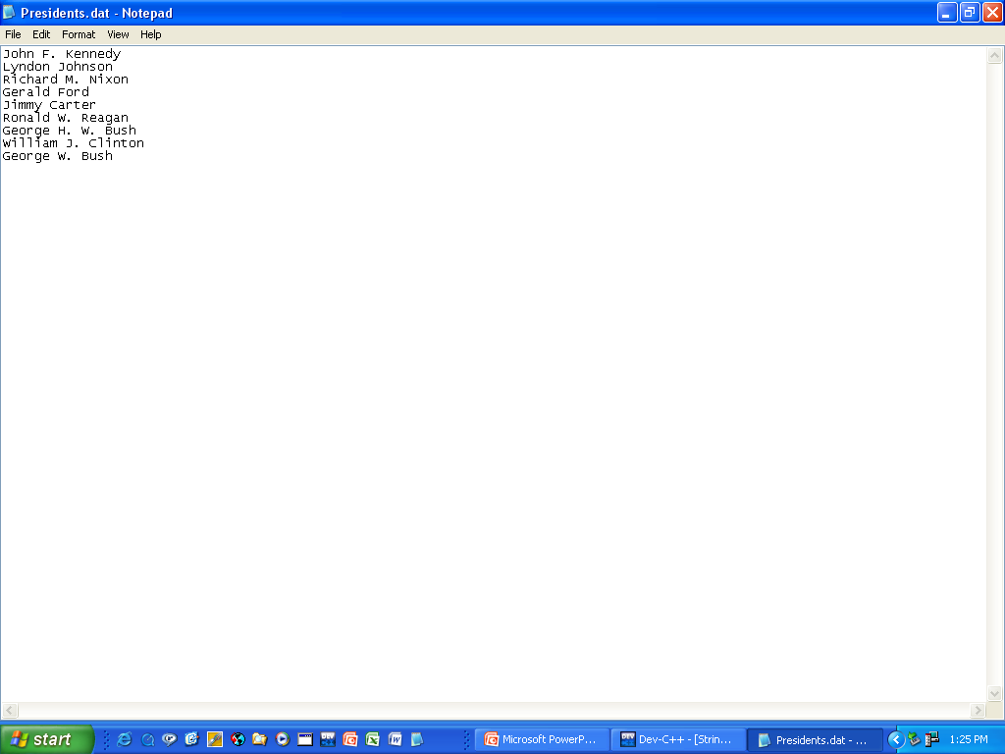
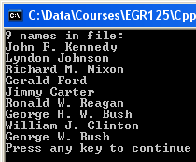
Reading strings into an array using getline
23
Notes:
23
23

Slide 24
Substrings
The member function substr is useful for extracting substrings out of existing strings.
Form: substr (index, num)
Typical usage: String1.substr (index, num) where
index = position in String1 for start of substring
num = number of characters in substring
Example:
string City, State;
string Location = “Virginia Beach, VA”;
City = Location.substr(0,14); // so City = “Virginia Beach”
State = Location.substr(16,2); // so State = “VA”
V | i | r | g | i | n | i | a |  | B | e | a | c | h | , |  | V | A
Pos:
0 | 1 | 2 | 3 | 4 | 5 | 6 | 7 | 8 | 9 | 10 | 11 | 12 | 13 | 14 | 15 | 16 | 17
24
Notes:
24
24

Slide 25
Using ignore with getline
If a number (int, double, etc.) is read from a keyboard or file, there may still be a newline character (‘\n’) in the input buffer or file. This may cause problems if getline is used directly after reading a number as getline may stop after reading the newline character.
One way to avoid this problem is to use the function ignore.
Form: ignore(NumberOfCharacters, ‘Terminator’)
Typical usage: cin.ignore(NumberOfCharacters, ‘Terminator’)
where
NumberOfCharacters = max number of characters to ignore before encountering terminator
Terminator = Final character to ignore
Examples:
cin.ignore(100,’\n’); // ignore up to 100 characters from the
// keyboard and stop after first ‘\n’ encountered
InData.ignore(50,’*’); // ignore up to 50 characters in the file
// designated by object InData and stop after first ‘*’ encountered
Notes:
25
25

Slide 26
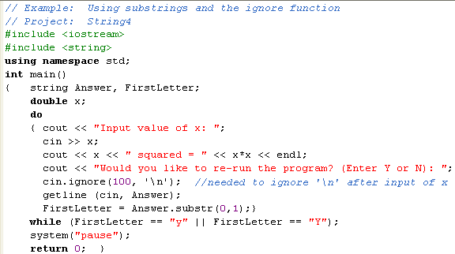
Example – using getline, substr, and ignore
The program below gives the user the option of re-running the program and will accept any input beginning with “y” or “Y” to re-run the program. The first letter of the response is extracted using substr.
26
Notes:
26
26

Slide 27
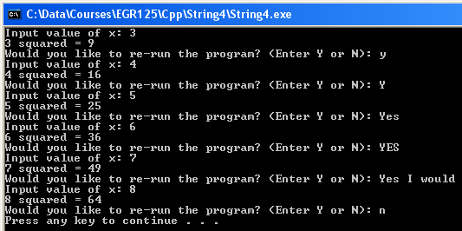
Example – using getline, substr, and ignore (continued)
Note that the program:
Re-runs for a variety of inputs that begin with the letter “Y” or “y”
Ignores the ‘\n’ after reading the input value of x
27
Notes:
27
27

Slide 28
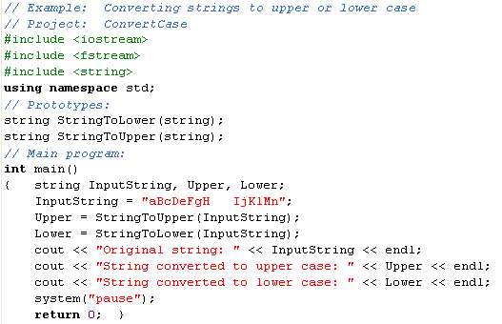
Example – strings and functions
Program that calls functions to convert strings to all upper case letters or all lower case letters.
28
Notes:
28
28

Slide 29
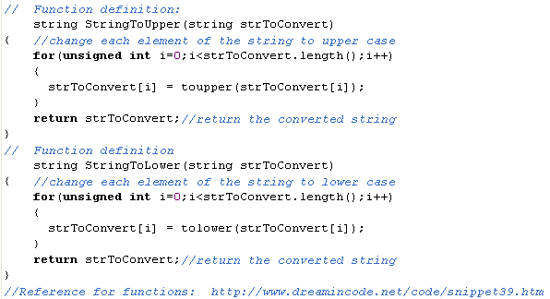
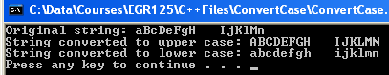
Note the use of the member function length()
29
Notes:
29
29

Slide 30
Class examples
Try one or more of the following examples in class
Use getline( ) to read in a person’s full name from the keyboard as a string (assume a simple form such as John Q. Doe).
Search for the spaces using find( ) and then define three new strings for FirstName, MiddleInitial, and LastName.
Form a new string with the initials (JQD, for example)
Form a new string with the form Doe, John Q. (as an example)
Read the person’s age before reading the name. Will you need to use ignore( )?
Create a data file containing a paragraph (make something up) and
Count the number of words
Count the number of letters
Count the number of 4-letter words
Count the number of words beginning with a certain letter
30
Notes:
30
30

